Slide 1
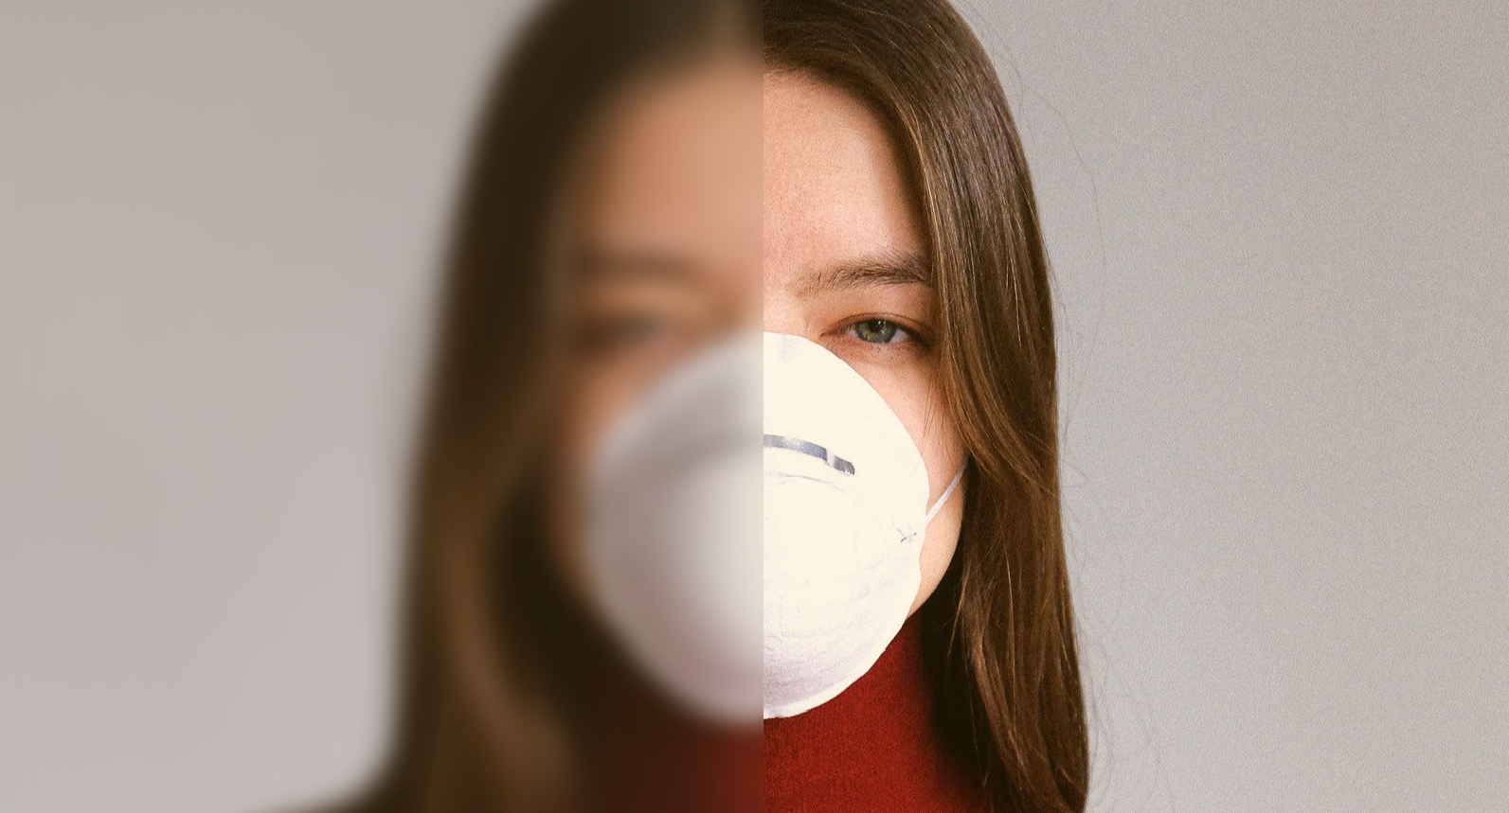
Suicide Prevention Using Social Media Post (Case Study Twitter)

Slide 2


Project Background
Suicide is a serious health problem and one of global concern
Suicide is the second leading cause of death from age 15-29
79% occurs in low and middle income countries
Reducing the suicide rate to 10% by 2030 are one of the UN Sustainable Development Goals

Slide 3
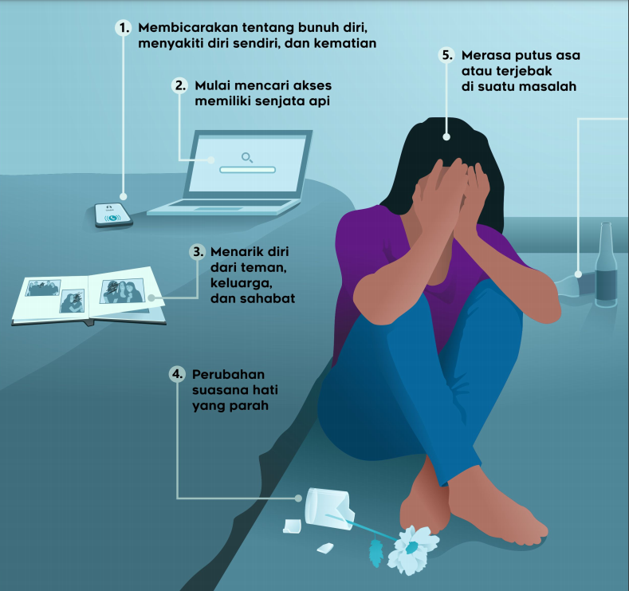
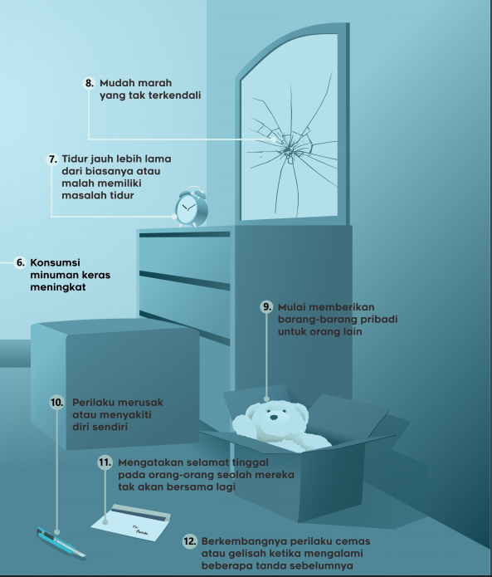


Slide 4

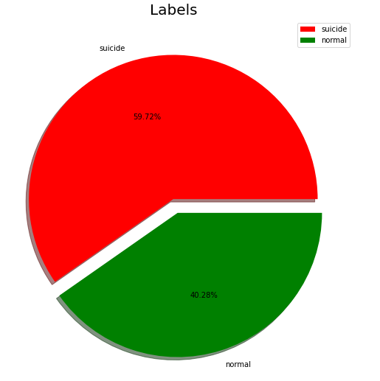
Our Goals
Is an application that aims to detect a person's twitter post whether they have suicidal tendencies or not. The words from the post will be processed and classified, which will be the percentage label.
Label are used in between :
Suicide
Normal

Slide 5

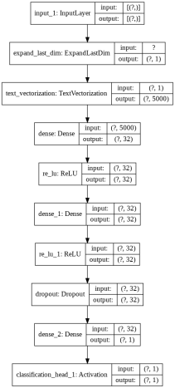
Project Layer

Slide 6

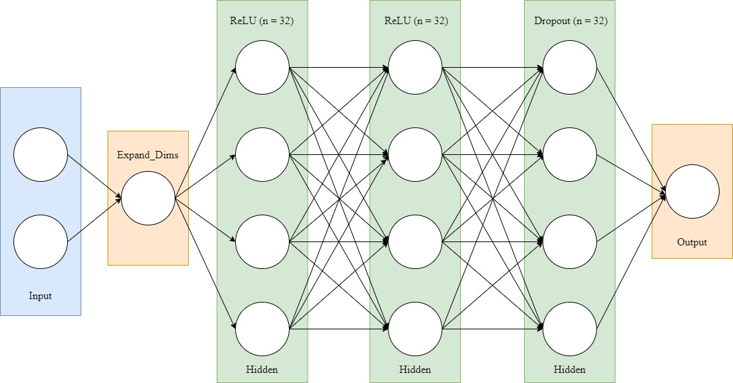
Pre-Processing
Model
Accuracy
Case Folding
Tokenization
Stemming
Lemmetizer
Text Vectorization
Best Accuracy 95,7%

Slide 7

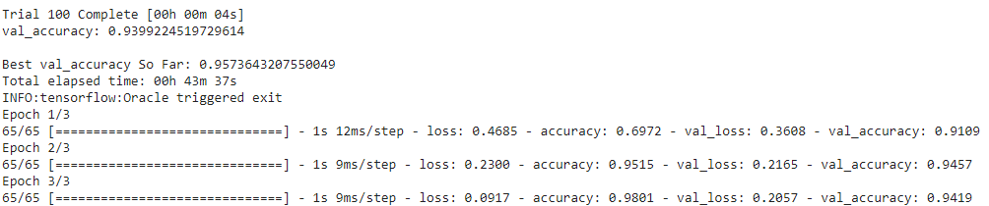

Slide 8

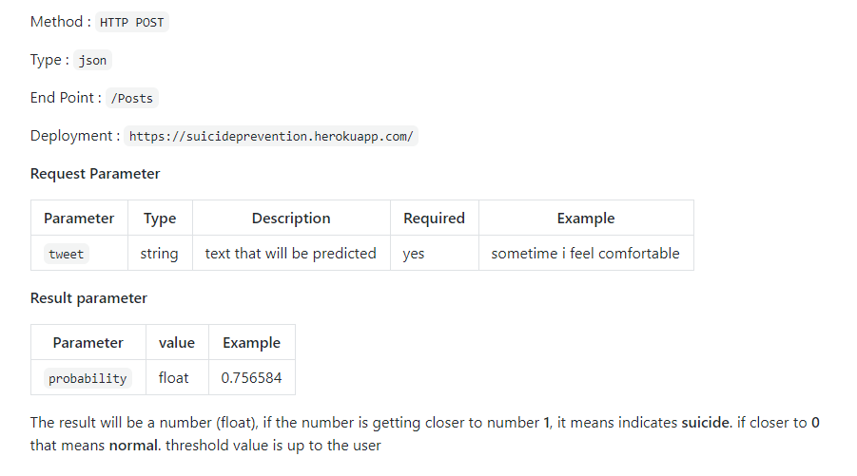
API Output
Suicide Prevention API provides access that can predict suicidal intention from text
API build from flask framework and deployed on heroku using POST /posts method to communicate with API

Slide 9

Solution
Social Media these days are like two sides of a coin, it provide us many things
To help and to gives
Seek a Help, Save a Life

Slide 10
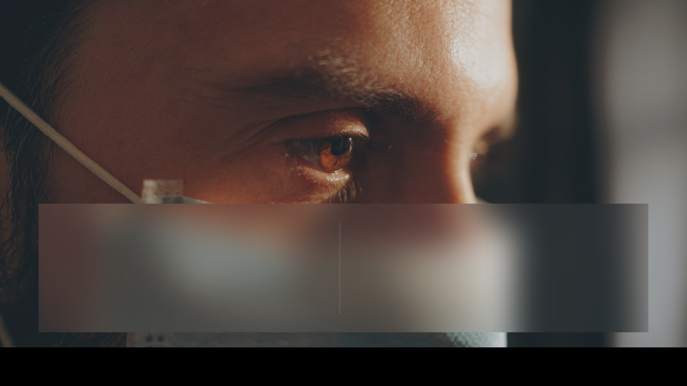
Future Project
However our project are far from perfection
Future research should expand the object to label more from what we called “mental illness”

